Slide 1




State Management in GraphQL / Apollo
By Vilva Athiban
@vilvaathibanpb
Vilva Athiban

Slide 2
About Me
Javascript Developer, Mostly on the Browser
Blogging in Medium - Vilva Athiban P B
I do cartoons on Tech and will soon release a complete tutorial on Apollo GraphQL in Youtube.
Twitter @vilvaathibanpb , Youtube - Vilva Athiban
Open Source contributor.
I code on JS, React, GraphQL these days.
Also, I love to teach

Slide 3
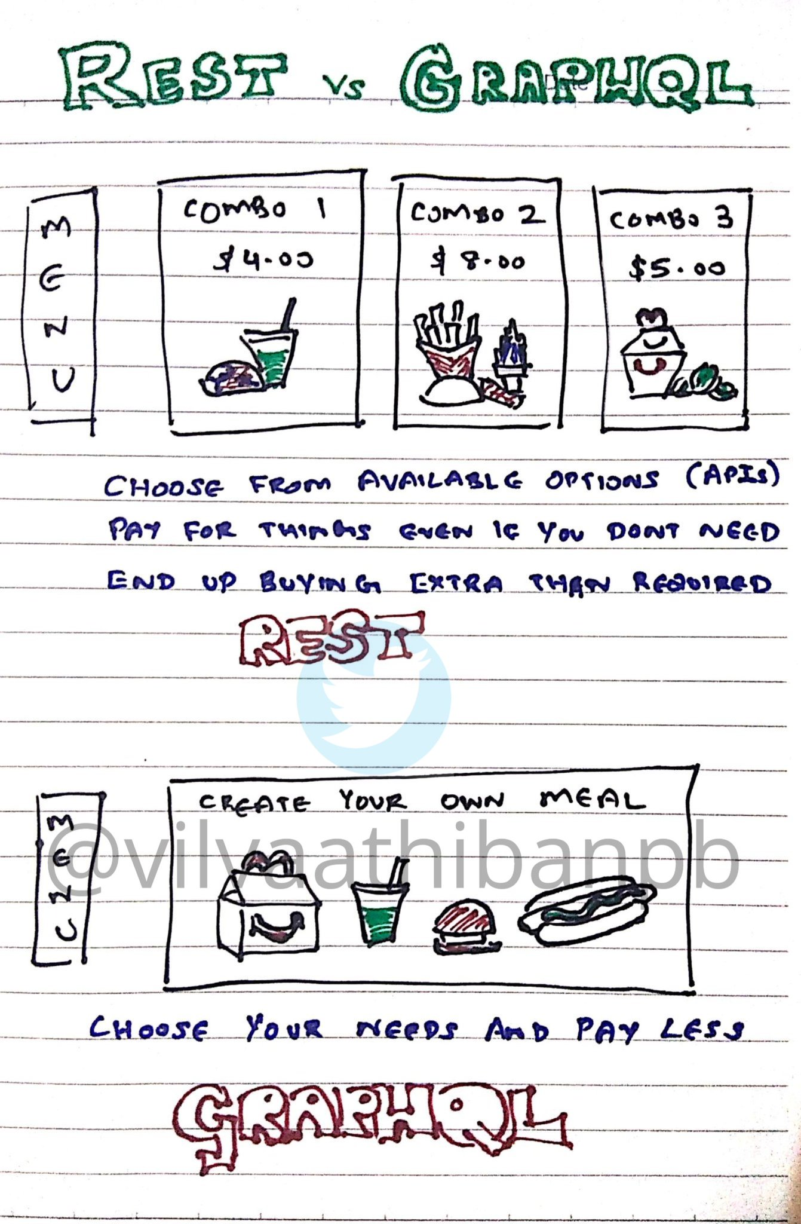

Slide 4


Slide 5
State Management - Anti Redux
Redux is a different Universe
Apollo uses cache for State Management
Still stick to Queries and Mutations
Combine Server and Local data in a single query

Slide 6

Demo & Code Walkthrough

Slide 7
Setup Local State in Apollo
Create TypeDefs for local queries / schema
Initialize the State
Setup Apollo Client with State

Slide 8
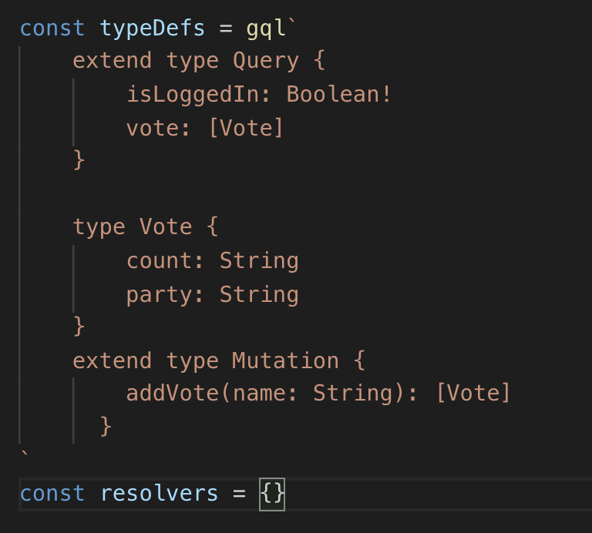
Create TypeDefs for local queries / schema

Slide 9
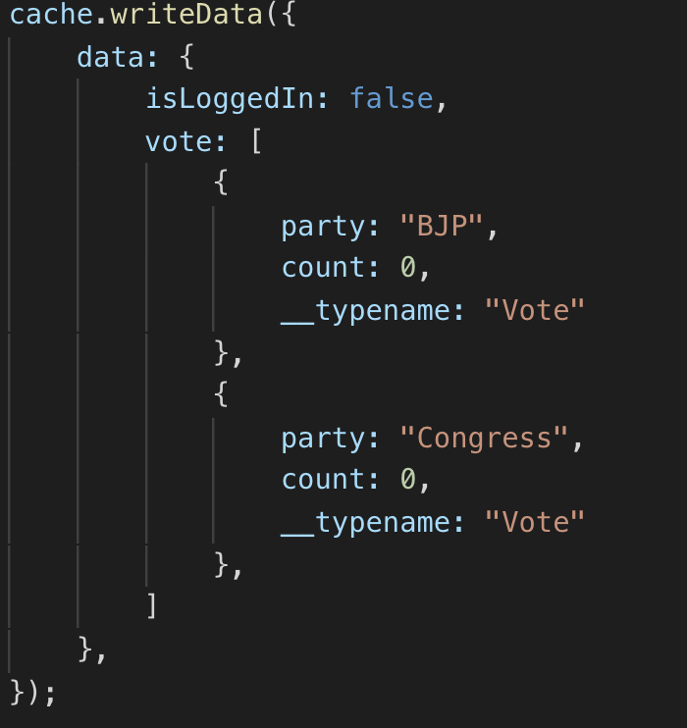
Initialize the State

Slide 10
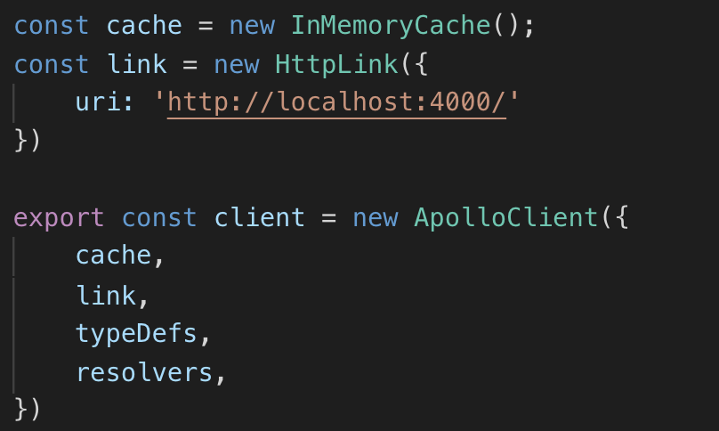
Setup Apollo Client with State

Slide 11
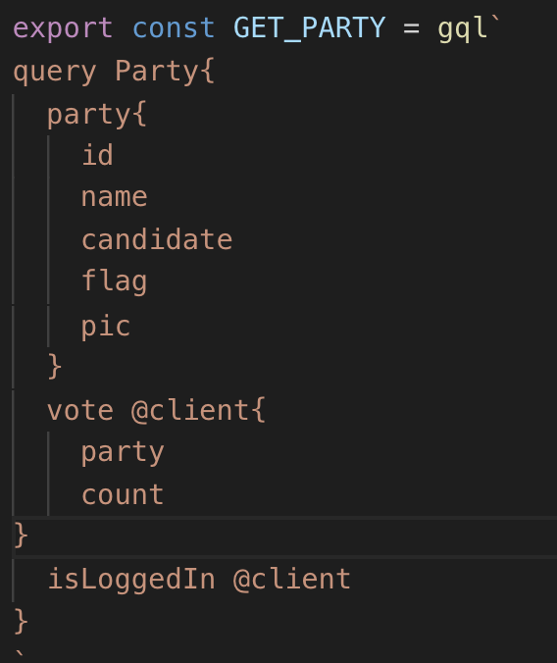
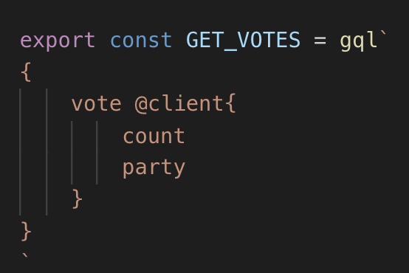
Read data from State - @client

Slide 12

Done Reading, Next ?

Slide 13
Write data into State
There are two ways of writing data into local State
Direct Write
Local Resolver / Mutation

Slide 14

Direct Write

Slide 15
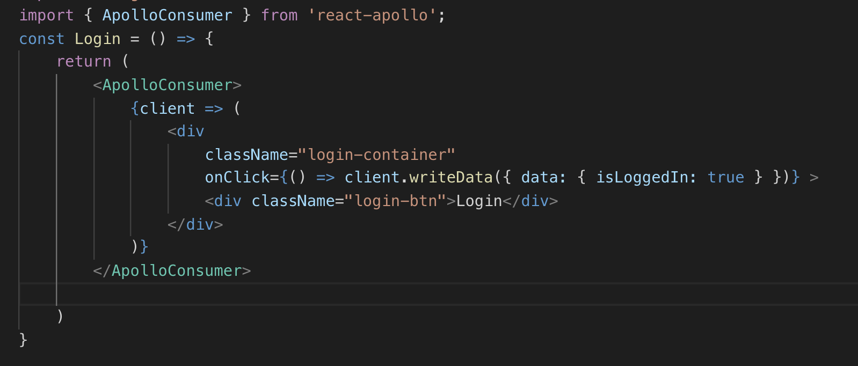
Direct Write

Slide 16

Local Resolver / Mutation

Slide 17
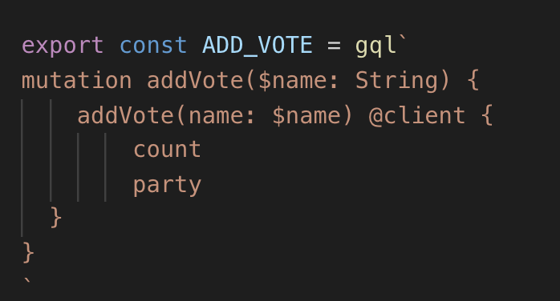
Local Resolver / Mutation - Declaring the Mutation

Slide 18
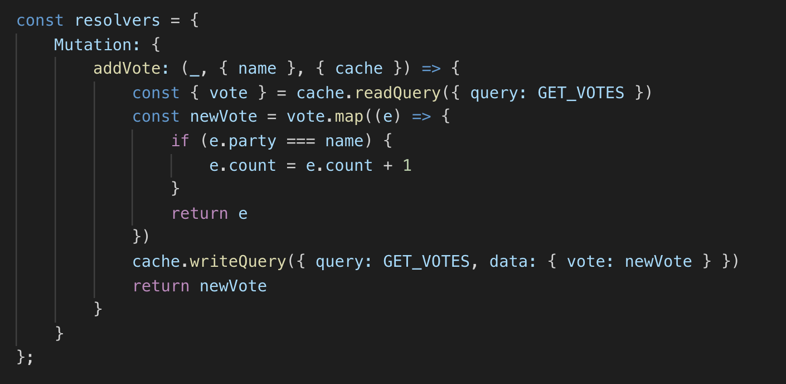
Local Resolver / Mutation - Creating Local Resolver

Slide 19
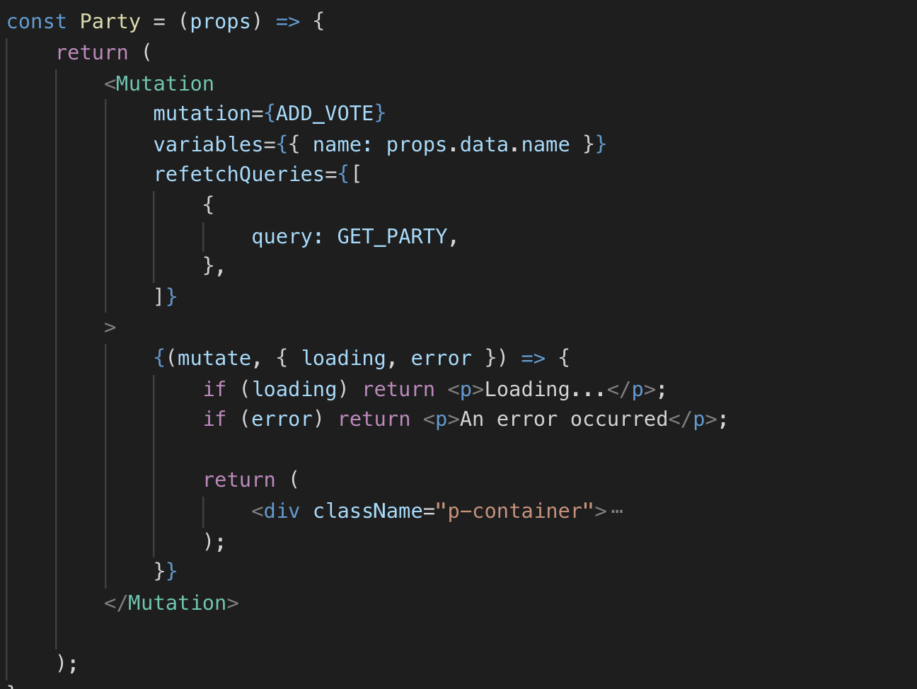
Local Resolver / Mutation - Triggering the Mutation from UI

Slide 20

Feeling Powerful with State Management ?

Slide 21
Further Reading ?
addResolvers / setResolvers
readFragment / writeFragment
@export
@client(always: true)

Slide 22

QA Time
Thank you !
Feedback and Suggestions are welcome
Available for offline discussions
Follow me on twitter - @vilvaathibanpb

